Slide 1

IP Apprenticeships

Slide 2

Introduction
Dr Bobby Mukherjee CPA, EPA, BAE Systems plc

Slide 3
Patent Scientist/Engineer
Level 6 Degree Apprenticeship
Sheila Wallace CPA, EPA, formerly Marks & Clerk LLP

Slide 4
Background
Intellectual property (IP) is the term given to creations of the human mind, e.g., inventions, the appearance of a product, logos, names and slogans, literary and artistic works, software, and confidential information.
IP is protected by various IP rights, including patents, designs, trade marks, and copyright.
Patent attorneys are qualified to give advice to inventors about patents and to act on their behalf, e.g., by drafting, filing and prosecuting patent applications, representing them before patent offices, and advising on the infringement and validity of granted patents.
Patent attorneys also know about other areas of IP law and are able to provide general advice on IP matters

Slide 5
Current qualification route
Need to have a STEM degree and then pass a series of exams
Exams to qualify as a Registered Patent Attorney in the UK are in 2 stages – Foundation Certificate (FC) and Final Diploma (FD)
Some universities provide postgraduate courses which lead to exemption from the FC exams
Exams to qualify as a European Patent Attorney, referred to as European Qualifying Exams (EQEs), comprise a Foundation exam and four Main exam papers with increasing levels of complexity which are sat at different time intervals

Slide 6
What does the apprenticeship entail?
Full-time apprenticeship
Apprentice is employed by an IP firm or in-house IP department and receives a salary while they are training
Apprentice spends part of their time (typically ~ 20%) studying for a university degree and part of their time (typically ~ 80%) working under the supervision of a European Patent Attorney
Study time could be 1 or 2 days a week or in short blocks

Slide 7
What qualification is obtained
Bachelor’s degree from an established UK university
Degree course will contain sufficient STEM subject matter to provide at least 144 ECTS credits – requirement to be eligible to sit European Qualifying Exams
Will also contain sufficient IP law and practice to provide an exemption from the UK Foundation Certificate (FC) exams

Slide 8
Entry Requirements
At least 120 UCAS points achieved via:
  3 A levels (minimum of 2 A levels in STEM subjects);
  International Baccalaureate (minimum of 2 STEM subjects at Higher level);
  T level in a relevant STEM subject; or
  equivalent qualifications

Slide 9
How long will the apprenticeship take?
Still to be confirmed, but currently working on a time scale of 4 years, including assessment
The apprentice will therefore also have several years of experience working under the supervision of a European Patent Attorney by the time the apprenticeship is completed.

Slide 10
Job opportunities on completion
Further study and training to qualify as a Registered Patent Attorney and/or European Patent Attorney, involving passing FD and/or EQE exams
Other roles in IP world, such as:
  marketing and business development
  business support
  searcher/analyst
  IT
  paralegal
  recruitment
  technology transfer

Slide 11
Next steps
Working towards apprenticeship being up and running by Autumn 2028
Currently focusing on computer science/digital technology as subject of STEM degree portion but plan to extend to engineering and chemistry/life sciences in the future

Slide 12
What is it like to be an apprentice on a Level 6 Degree Apprenticeship course?
Paul Armstrong, Head of Apprenticeships and Employer Skills,
University of Cumbria

Slide 13
L6 Patent Engineer
Being developed for September 2028 intake.
Four-year integrated degree apprenticeship (80% STEM and 20% Legal).
Law modules meet the requirements for the IP Foundation Certificate.
Assessment is all on-programme, through academic assessments link to modules of study (a mix of reports, projects, and legal exams).
Applications are directly to the University (training provider) sponsored by your employer; you will need to secure the apprenticeship role with the employer.
We will be working with employers to shape vacancies for Sep28.
Open to early career (college leavers) or existing staff upskilling.

Slide 14
Approach to Delivery
Taught online, backed by a virtual classroom.
24/7 online digital library and remote access student support.
Engineering & Digital week-long residential learning at our Barrow Campus.
Law week-long residential learning at our London Campus.
One Residential Week per Semester
(three per year).
Access to your local university library for quiet study space.
Nominated line manager in a suitable role.
Dedicated Personal University Tutor.

Slide 15
Being an apprentice
Complete academic modules to develop your body of knowledge and applied skills with assignments aligned to work-based learning.
Commit to a day a week to structured learning, plus gaining in-work experience through supervised work (learning on the job).
Record your active learning in the classroom and in work each month against planned hours set out in your learning plan.
As an apprentice, the course is no cost to you, and whilst you are studying you are working, earning and gaining valuable experience.
We meet with you and your employer at least each semester (3 times) and review your academic and professional progress.

Slide 16
You are in good company...
Ranked 5th University for Apprenticeships
(Large providers with over 500 starts in 24/25)
2024 Times Higher award for Widening Participation
Ofsted Good
2024
950 apprenticeship starts per year
2,500 completions and counting
84%
Qualification Achievement Rate

Slide 17

Our new campus in Barrow, focused on engineering, advanced manufacturing and digital technology the base for residential learning.
We are also one of the founding members of the Defence Universities Alliance.

Slide 18
Level 3 IP Paralegal Apprenticeship
Annemarie Parsons, Murgitroyd

Slide 19
What is it like to be an apprentice on an IP Paralegal Apprenticeship?
Katrina Shawcross, Damar Training

Slide 20
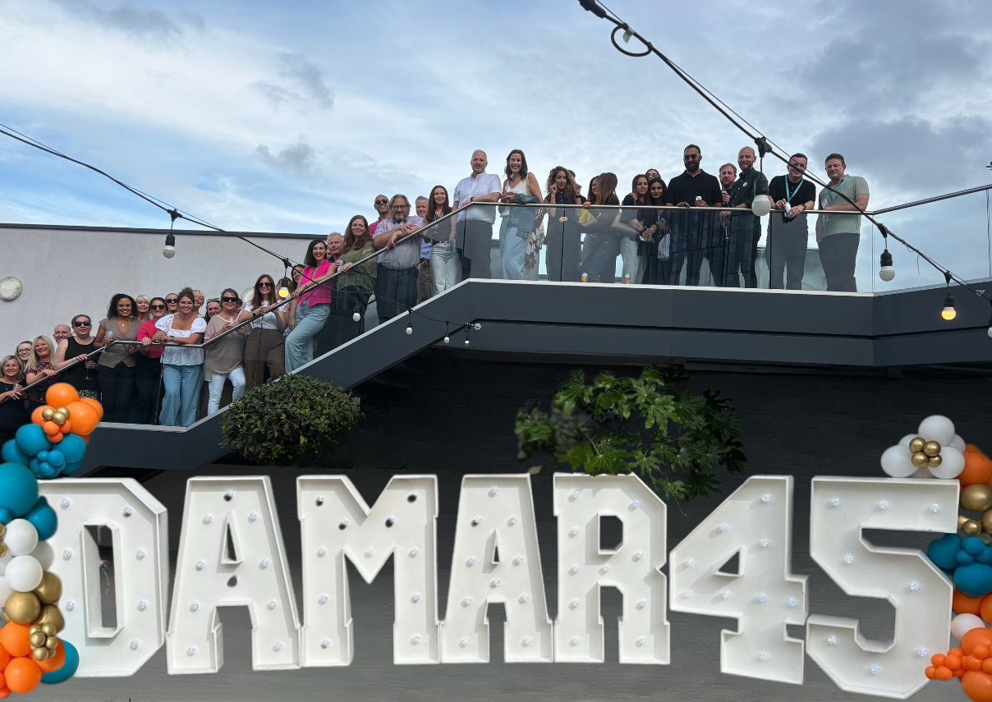
Who we are
Independent apprenticeship training provider – since 1980
Work nationally (England)
Specialise in business and professional support services – especially legal
c.1,500 apprentices with c.650 employers; over 50% in legal services
Apprenticeship training and recruitment support
Apprenticeships include paralegal, chartered legal executive, solicitor, business administration, accountancy, customer service, data protection.

Slide 21

Benefits of apprenticeships
Earn while you learn: Receive a salary whilst gaining qualifications
Gain real work experience: Develop practical skills in a real workplace, which employers value
Recognised qualifications: Apprenticeships are nationally recognised qualifications
Improve career prospects: Many apprentices are offered permanent jobs or promotions after completion
Develop transferable skills: Build communication, teamwork, problem-solving, time management, and confidence
No tuition costs: All training costs are covered by the employer and government
Progression: Apprenticeships can lead to higher-level qualifications including university-level
Learn from experienced professionals: Receive support and mentoring from colleagues and tutors
Build a professional network: Make valuable career connections
Increase earning potential: Qualifications and work experience can lead to higher salaries over time.

Slide 22

Eligibility
Be 16 years old or over
Live in England
Not be in full-time education
Have the right to work in the UK
Have a skills gap and do not already hold a similar or higher qualification, such as a T-Level in legal services or a law degree
Meet any entry requirements set by the employer such as GCSEs and an A-Level in law.

Slide 23

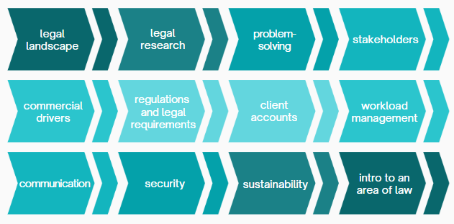

Paralegal apprenticeship overview
Level: 3
Duration: 21 months
End-Point Assessment (EPA): Professional discussion and portfolio; project report, presentation and Q&A
Assessment Organisation: (AO): Summit
Modules: 14

Slide 24

Delivery and support
Blended learning
Online content
Live workshops
Regular knowledge checks
Peer to peer activities.
Support
1-2-1 dedicated coaching sessions (6-weekly)
Dedicated off-the-job time (OTJ) to complete work and attend workshops or coaching sessions
12 x group coaching sessions to help with portfolio build
7 group workshops led by expert tutors
Additional support available throughout where needed, including English, maths, learning needs or disabilities.

Slide 25

Core themes
Legal and regulatory understanding
Ethical and compliance-based judgement
Stakeholder engagement and communication skills
Advanced legal research and analytical problem-solving
Digital tools and commercial awareness
Caseload management and professional accountability.

Slide 26
Specialist content – IP pathway
Core foundations: IP fundamentals, regulatory bodies, ownership rights, confidentiality, and the paralegal role in private practice vs in-house settings
Patents: UK and European Patent (EP) filing, prosecution, and renewals; Unitary Patent/UPC system; PCT international applications and national phase entries
Designs: UK and Hague international design systems, including unregistered rights and post-Brexit EU considerations
Trademarks: UK filing and prosecution; Madrid Protocol for international registrations
Enforcement and other IP: Patent, trademark, and design oppositions, appeals, and infringement; litigation procedures; trade secrets, copyright, and domain names.

Slide 27

How to find apprenticeship opportunities
Damar apprenticeship vacancies
Register now with our recruitment team
Find an apprenticeship - Register and search apprenticeship vacancies all year round
Get My First Job - Register and search apprenticeship vacancies all year round
Not Going to Uni - Register and search apprenticeship vacancies all year round
Be proactive! Reach out to employers you'd like to work for and ask whether they would consider recruiting you as an apprentice. If they are interested, pass on our contact details and we can discuss how the apprenticeship works, including funding, incentives and the next steps involved in offering you an apprenticeship opportunity.
Find out more about becoming an apprentice and the benefits of apprenticeships here.
We wish you the very best of luck with your future.

Slide 28
Q&A

Slide 29
Thank you for your attention!
For more information, please contact:
The Chartered Institute of Patent Attorneys
2nd Floor, Viaro House, 20-23 Holborn, London EC1N 2JD
Tel: +44 (0)20 7405 9450
Email: mail@cipa.org.uk

