Slide 1

Careers in Intellectual Property

Slide 2
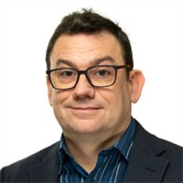
Introduction
Chris Burnett
Partner , Chartered Patent Attorney and European Patent Attorney

Slide 3

Agenda
What is Intellectual Property?
Creative Context
Where IP fits in
Roles in IP
Questions/Get in touch
Notes:
Not constantly worrying about keeping aspects of themselves hidden. If you’re worrying about people finding out you’re gay, or that you’ve suffered from depression; if you’re working extra hard to prove yourself because you’re the only woman or the only person of colour and people are viewing you with suspicion, how can you perform at your best?

Slide 4
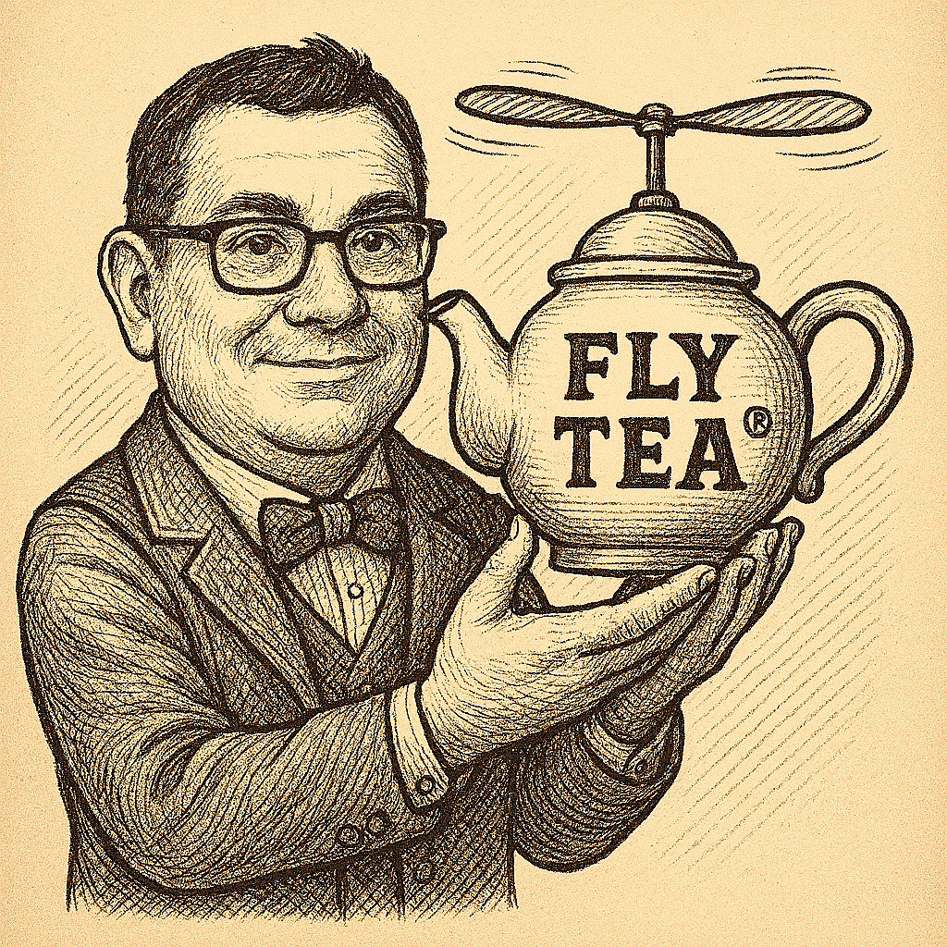
What is Intellectual Property?
“Creations of the mind”
Intellectual property rights (IPRs) protect these creations of the mind
Copyright protects works such as literary or musical works and computer programs ©
Notes:
Not constantly worrying about keeping aspects of themselves hidden. If you’re worrying about people finding out you’re gay, or that you’ve suffered from depression; if you’re working extra hard to prove yourself because you’re the only woman or the only person of colour and people are viewing you with suspicion, how can you perform at your best?

Slide 5
What is Intellectual Property?
Patents protect inventions, such as new products and processes
Trade marks protect brands ®
Design rights protect the shape and configuration of products
Notes:
Not constantly worrying about keeping aspects of themselves hidden. If you’re worrying about people finding out you’re gay, or that you’ve suffered from depression; if you’re working extra hard to prove yourself because you’re the only woman or the only person of colour and people are viewing you with suspicion, how can you perform at your best?

Slide 6
Careers in creation…and careers in protection!
• These roles require a whole range of skills, knowledge and interests
• Summer of IP will go into more detail about many of the roles
• See also https://careersinideas.org.uk/
and careers booklet for more information
Notes:
Not constantly worrying about keeping aspects of themselves hidden. If you’re worrying about people finding out you’re gay, or that you’ve suffered from depression; if you’re working extra hard to prove yourself because you’re the only woman or the only person of colour and people are viewing you with suspicion, how can you perform at your best?

Slide 7
Creative context
Notes:
Not constantly worrying about keeping aspects of themselves hidden. If you’re worrying about people finding out you’re gay, or that you’ve suffered from depression; if you’re working extra hard to prove yourself because you’re the only woman or the only person of colour and people are viewing you with suspicion, how can you perform at your best?

Slide 8
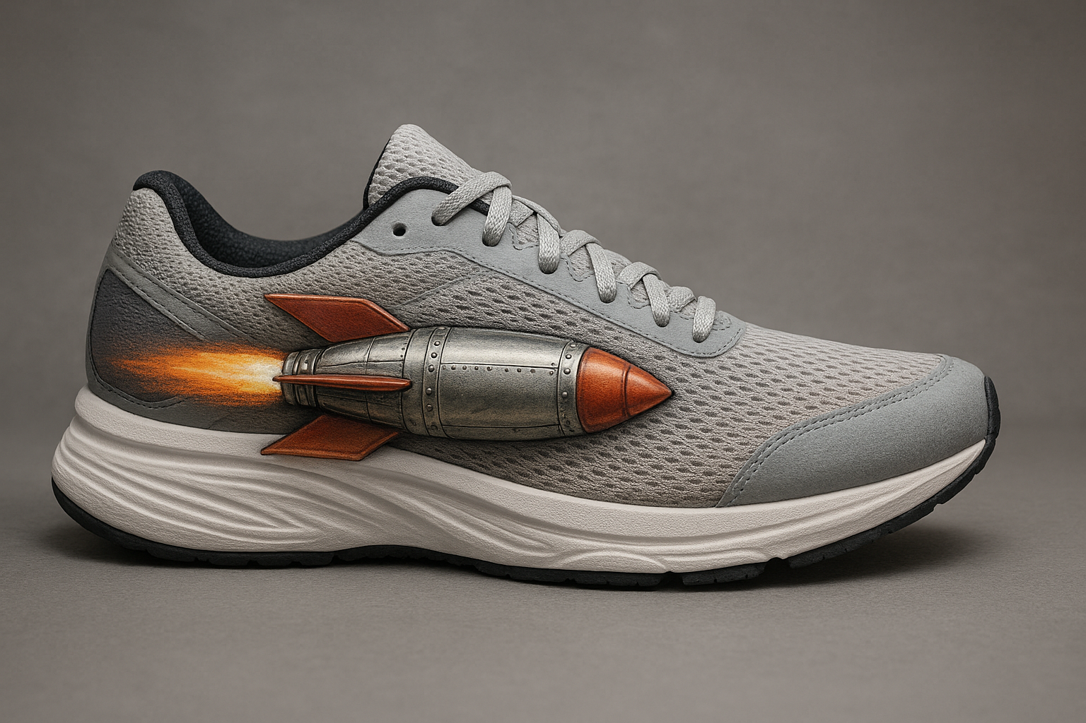
Idea
Most new ideas aren’t very new
Most are adaptations or improvements
Research
• Product validation ensures you’re creating a product people will pay for
• Analyse what competitors are doing
• Due diligence – What IP is out there?
Notes:
Not constantly worrying about keeping aspects of themselves hidden. If you’re worrying about people finding out you’re gay, or that you’ve suffered from depression; if you’re working extra hard to prove yourself because you’re the only woman or the only person of colour and people are viewing you with suspicion, how can you perform at your best?

Slide 9
Develop
• Plan for what the finished product
may look like
• Prototype – make a model
Testing
• Test against the design criteria
• Does it work? Does it break?
Notes:
Not constantly worrying about keeping aspects of themselves hidden. If you’re worrying about people finding out you’re gay, or that you’ve suffered from depression; if you’re working extra hard to prove yourself because you’re the only woman or the only person of colour and people are viewing you with suspicion, how can you perform at your best?

Slide 10
Analysis
• A review of the sales, costs and profit projections for the new product
• Do these factors satisfy the company’s objectives?
Research
• Product validation ensures you’re creating a product people will pay for
• Analyse what competitors are doing
• Due diligence – What IP is out there?
Notes:
Not constantly worrying about keeping aspects of themselves hidden. If you’re worrying about people finding out you’re gay, or that you’ve suffered from depression; if you’re working extra hard to prove yourself because you’re the only woman or the only person of colour and people are viewing you with suspicion, how can you perform at your best?

Slide 11
Where does IP fit in?
• Idea stage - new invention? patentable?
• Research stage – has anyone thought of it before? Search!
• Development – Starts to take physical shape. Design protection
• Test – Any new developments or ideas to protect? Any brand names?
• Analysis – push ahead with protection, think about territories
• Intro – the product is on the market!
Infringers beware!
Notes:
Not constantly worrying about keeping aspects of themselves hidden. If you’re worrying about people finding out you’re gay, or that you’ve suffered from depression; if you’re working extra hard to prove yourself because you’re the only woman or the only person of colour and people are viewing you with suspicion, how can you perform at your best?

Slide 12

Patent attorneys
• Patent attorneys file patent applications
• They provide pre-filing advice
• They can also manage the patent once it has granted
Notes:
Not constantly worrying about keeping aspects of themselves hidden. If you’re worrying about people finding out you’re gay, or that you’ve suffered from depression; if you’re working extra hard to prove yourself because you’re the only woman or the only person of colour and people are viewing you with suspicion, how can you perform at your best?

Slide 13
Patent attorneys
• They will be involved at the Idea stage and the Research Stage
• They will try to protect the idea
• Analyse competitor rights
• Develop and Analysis stages
• After the Intro stage
Notes:
Not constantly worrying about keeping aspects of themselves hidden. If you’re worrying about people finding out you’re gay, or that you’ve suffered from depression; if you’re working extra hard to prove yourself because you’re the only woman or the only person of colour and people are viewing you with suspicion, how can you perform at your best?

Slide 14
Patent attorneys
• Technical specialist
• STEM degree
• Learn on the job
• In-house or private practice
Notes:
Not constantly worrying about keeping aspects of themselves hidden. If you’re worrying about people finding out you’re gay, or that you’ve suffered from depression; if you’re working extra hard to prove yourself because you’re the only woman or the only person of colour and people are viewing you with suspicion, how can you perform at your best?

Slide 15
Patent Analyst
• Look for earlier patent rights
• They provide pre-filing advice
• Look for later filings by competitors
• Landscape
Notes:
Not constantly worrying about keeping aspects of themselves hidden. If you’re worrying about people finding out you’re gay, or that you’ve suffered from depression; if you’re working extra hard to prove yourself because you’re the only woman or the only person of colour and people are viewing you with suspicion, how can you perform at your best?

Slide 16
Patent Analyst
• They will be involved at the Idea
stage and the Research Stage
• Due diligence
• Locate competitor rights
• Develop and Analysis stages
• After the Intro stage
Notes:
Not constantly worrying about keeping aspects of themselves hidden. If you’re worrying about people finding out you’re gay, or that you’ve suffered from depression; if you’re working extra hard to prove yourself because you’re the only woman or the only person of colour and people are viewing you with suspicion, how can you perform at your best?

Slide 17
Patent Analyst
• Technical specialist
• STEM degree
• Learn on the job
• In-house or private practice
Notes:
Not constantly worrying about keeping aspects of themselves hidden. If you’re worrying about people finding out you’re gay, or that you’ve suffered from depression; if you’re working extra hard to prove yourself because you’re the only woman or the only person of colour and people are viewing you with suspicion, how can you perform at your best?

Slide 18
Patent Examiner
• Examine patent applications
• Patent hearings
Notes:
Not constantly worrying about keeping aspects of themselves hidden. If you’re worrying about people finding out you’re gay, or that you’ve suffered from depression; if you’re working extra hard to prove yourself because you’re the only woman or the only person of colour and people are viewing you with suspicion, how can you perform at your best?

Slide 19
Patent Examiner
• Technical specialist
• STEM degree
• Work at UK Intellectual Property
Office or European Patent Office
Notes:
Not constantly worrying about keeping aspects of themselves hidden. If you’re worrying about people finding out you’re gay, or that you’ve suffered from depression; if you’re working extra hard to prove yourself because you’re the only woman or the only person of colour and people are viewing you with suspicion, how can you perform at your best?

Slide 20
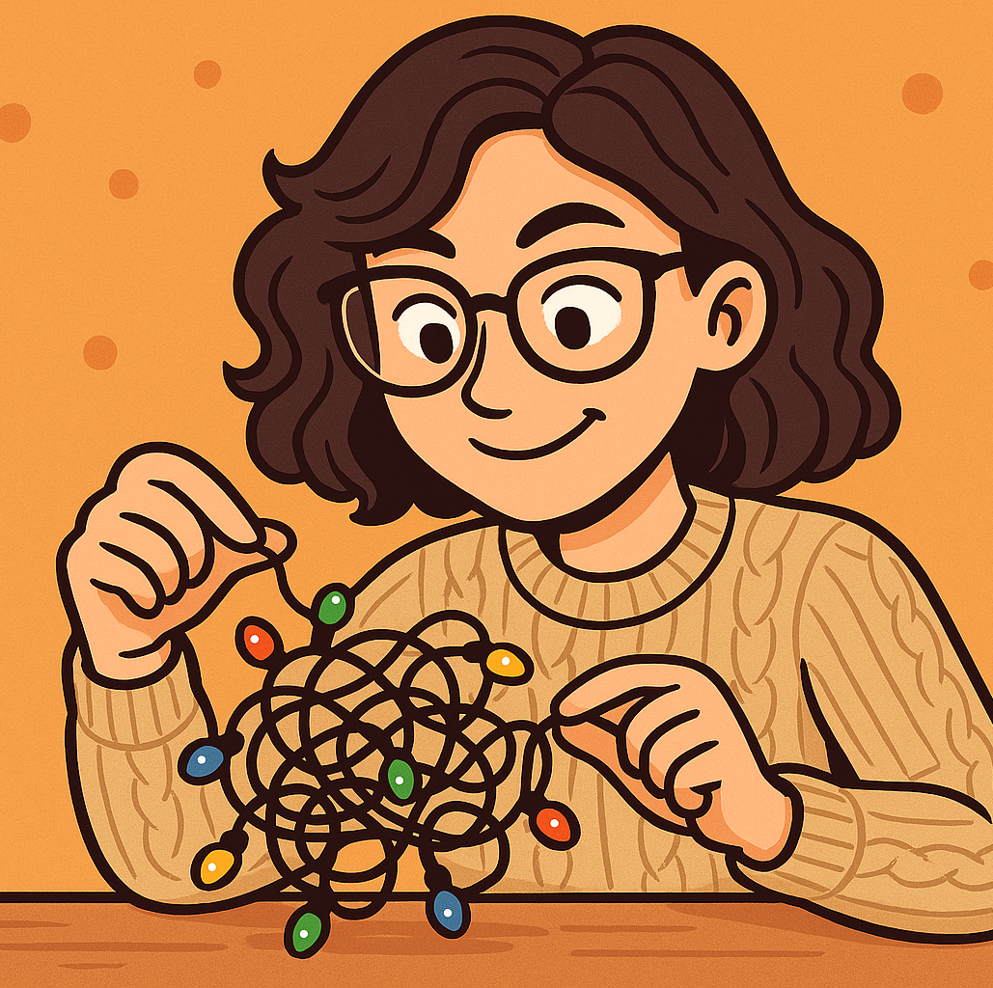
Skills to pay the bills
• To be a good patent attorney,
analyst or examiner, you will need:
- a good analytical mind
- be good at solving puzzles
- be good at communicating ideas
Notes:
Not constantly worrying about keeping aspects of themselves hidden. If you’re worrying about people finding out you’re gay, or that you’ve suffered from depression; if you’re working extra hard to prove yourself because you’re the only woman or the only person of colour and people are viewing you with suspicion, how can you perform at your best?

Slide 21
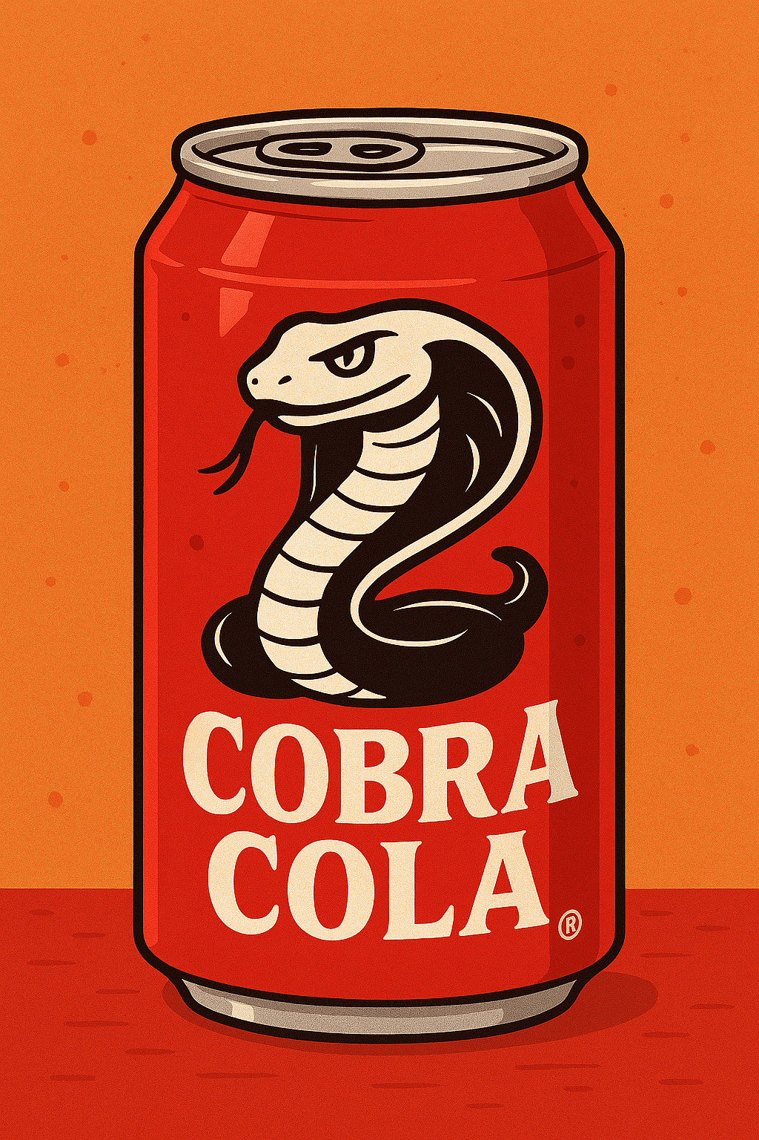
Trade mark attorneys
• Trade mark attorneys file trade mark applications
• They provide pre-filing advice
• They can also manage the trade mark rights once they are registered
Notes:
Not constantly worrying about keeping aspects of themselves hidden. If you’re worrying about people finding out you’re gay, or that you’ve suffered from depression; if you’re working extra hard to prove yourself because you’re the only woman or the only person of colour and people are viewing you with suspicion, how can you perform at your best?

Slide 22
Trade mark attorneys
To become a trade mark attorney you generally need a degree (does not need to be a particular subject)
Learn on the job
Nottingham
In-house or private practice
Notes:
Not constantly worrying about keeping aspects of themselves hidden. If you’re worrying about people finding out you’re gay, or that you’ve suffered from depression; if you’re working extra hard to prove yourself because you’re the only woman or the only person of colour and people are viewing you with suspicion, how can you perform at your best?

Slide 23
Trade mark attorneys
• The main skills for being a good trade mark attorney are having an analytical mind and great communication skills
• Trade mark law is very fast moving
Notes:
Not constantly worrying about keeping aspects of themselves hidden. If you’re worrying about people finding out you’re gay, or that you’ve suffered from depression; if you’re working extra hard to prove yourself because you’re the only woman or the only person of colour and people are viewing you with suspicion, how can you perform at your best?

Slide 24
Trade mark examiner
• The UK Intellectual Property Office
examines trade mark applications
• Trade mark examiners do not require
a degree – so may suit people who
do not wish to go to University
• Requires a very good analytical mind
and good use of language
Notes:
Not constantly worrying about keeping aspects of themselves hidden. If you’re worrying about people finding out you’re gay, or that you’ve suffered from depression; if you’re working extra hard to prove yourself because you’re the only woman or the only person of colour and people are viewing you with suspicion, how can you perform at your best?

Slide 25
Enforcement of rights
• Competitors will assess the new sole
• They can copy or design around it
• What roles are there for Intellectual
Property professionals from here?
Notes:
Not constantly worrying about keeping aspects of themselves hidden. If you’re worrying about people finding out you’re gay, or that you’ve suffered from depression; if you’re working extra hard to prove yourself because you’re the only woman or the only person of colour and people are viewing you with suspicion, how can you perform at your best?

Slide 26
Intellectual Property
(IP) Solicitors
• Various routes into the profession
• LPC
• SQE
• SQA
Notes:
Not constantly worrying about keeping aspects of themselves hidden. If you’re worrying about people finding out you’re gay, or that you’ve suffered from depression; if you’re working extra hard to prove yourself because you’re the only woman or the only person of colour and people are viewing you with suspicion, how can you perform at your best?

Slide 27
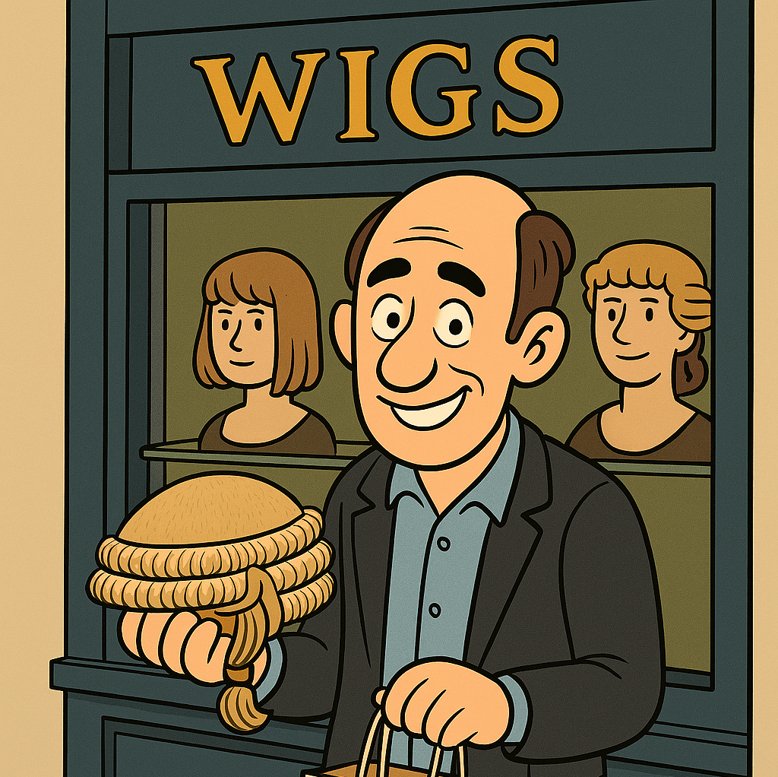
Intellectual Property
Barristers
• Barristers specialise in representing clients in litigious matters
• May work alongside IP solicitors and patent and trademark attorneys
Notes:
Not constantly worrying about keeping aspects of themselves hidden. If you’re worrying about people finding out you’re gay, or that you’ve suffered from depression; if you’re working extra hard to prove yourself because you’re the only woman or the only person of colour and people are viewing you with suspicion, how can you perform at your best?

Slide 28
Intellectual Property
Barristers
• Undergraduate degree – may be
STEM
• Conversion course e.g. PGDL
• Bar Practice Course
• Pupillage
Notes:
Not constantly worrying about keeping aspects of themselves hidden. If you’re worrying about people finding out you’re gay, or that you’ve suffered from depression; if you’re working extra hard to prove yourself because you’re the only woman or the only person of colour and people are viewing you with suspicion, how can you perform at your best?

Slide 29
Finance
• Insurance roles
• Intellectual Property backed lending
• Mergers and acquisitions
• Intellectual Property valuation
Notes:
Not constantly worrying about keeping aspects of themselves hidden. If you’re worrying about people finding out you’re gay, or that you’ve suffered from depression; if you’re working extra hard to prove yourself because you’re the only woman or the only person of colour and people are viewing you with suspicion, how can you perform at your best?

Slide 30
Administrative/
Support roles
• Many essential and rewarding support roles do not require a technical background or a degree
• A lot of Intellectual Property work is transactional
Notes:
Not constantly worrying about keeping aspects of themselves hidden. If you’re worrying about people finding out you’re gay, or that you’ve suffered from depression; if you’re working extra hard to prove yourself because you’re the only woman or the only person of colour and people are viewing you with suspicion, how can you perform at your best?

Slide 31
Administrative/
Support roles
• Roles and job titles will depend on the firm and the level of responsibility
• High levels of organisational skills and attention to detail
Notes:
Not constantly worrying about keeping aspects of themselves hidden. If you’re worrying about people finding out you’re gay, or that you’ve suffered from depression; if you’re working extra hard to prove yourself because you’re the only woman or the only person of colour and people are viewing you with suspicion, how can you perform at your best?

Slide 32
Thank you for listening
– Enjoy your
Summer of IP!!
https://careersinideas.org.uk/contact-us/

