Slide 1

Patent Attorney

Slide 2

What does a Patent Attorney do?
Protecting Technical Innovation
Ideas can change the world; Ideas can be worth £billions.
Patents protect innovation and release the potential of ideas.
Patents are national/regional legal rights that can protect inventions for up to 20 years.
Works at the cutting edge of technology. A world of intrigues and breakthroughs.
Collaborates with inventors and entrepreneurs in various technical fields to protect and defend innovation.
Respected legal/technical profession with UK and European qualifications. Good pay and clear pathways to promotion. Work in private practice or in-house.
Notes:
Release the potential of ideas: Careers like patent solicitors help to take ideas into the real world where people can invest in them, manufacture them and change lives with them. For example, cholesterol drug Lipitor is one of the world’s most valuable patents. By the time the patent ran out in 2009, it had earned over £72 billion and the drug had helped millions of people. It might never have been developed if the idea couldn’t be protected and made profitable.
At the cutting edge of technology: When inventors push the boundaries of innovation, people who work in IP are the first to hear about it. For example, a patent for a product almost identical to the iPod was filed as long ago as 1979, 23 years before Apple launched their product.
A world of intrigues and breakthroughs: The world of IP is a world of trade secrets (eg. the flavouring of Pot Noodles), of disputes between Marconi and Tesla about who invented the radio, and of legal battles like the one between Apple and Motorola over whether Motorola’s system of unlocking a phone by tapping the screen breached Apple’s patent on the swipe to unlock because, as they argued, ‘a tap is a zero-length swipe’.
Ideas can change the world: eg The Wright brothers were granted a patent for their ‘Flying-Machine’. We now call them ‘planes’.
Ideas can be worth £billions: Think of J K Rowling: her wealth comes from her ideas, protected by her ‘copyright’.
Work with inventors, entrepreneurs, artists, musicians and writers: The all need to protect the intellectual property in their ideas and they come to the IP specialists to help them.
Respected professions with good pay
Clear pathways to promotion

Slide 3
The skills you need
General & Legal Skills
Patent attorney profession needs people with
these skills and interests:
Creativity
Good communication
Excellent written skills
Qualifications in Patent Law
Attention to Detail
Organisation
Science Skills
Qualifications/experience in STEM subject
Love and understanding of science
Analytical skills

Slide 4
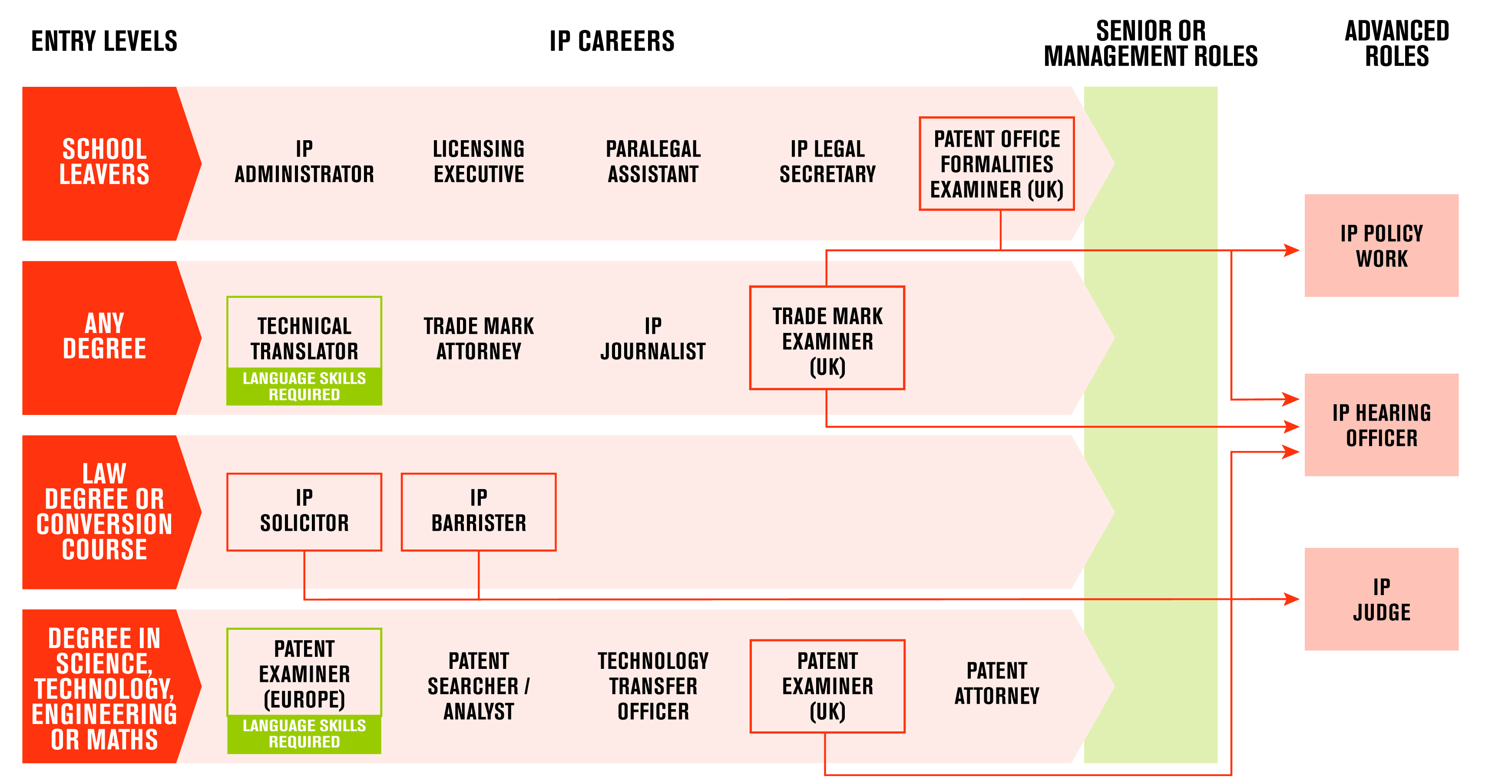
Other Careers in Ideas

