Slide 1
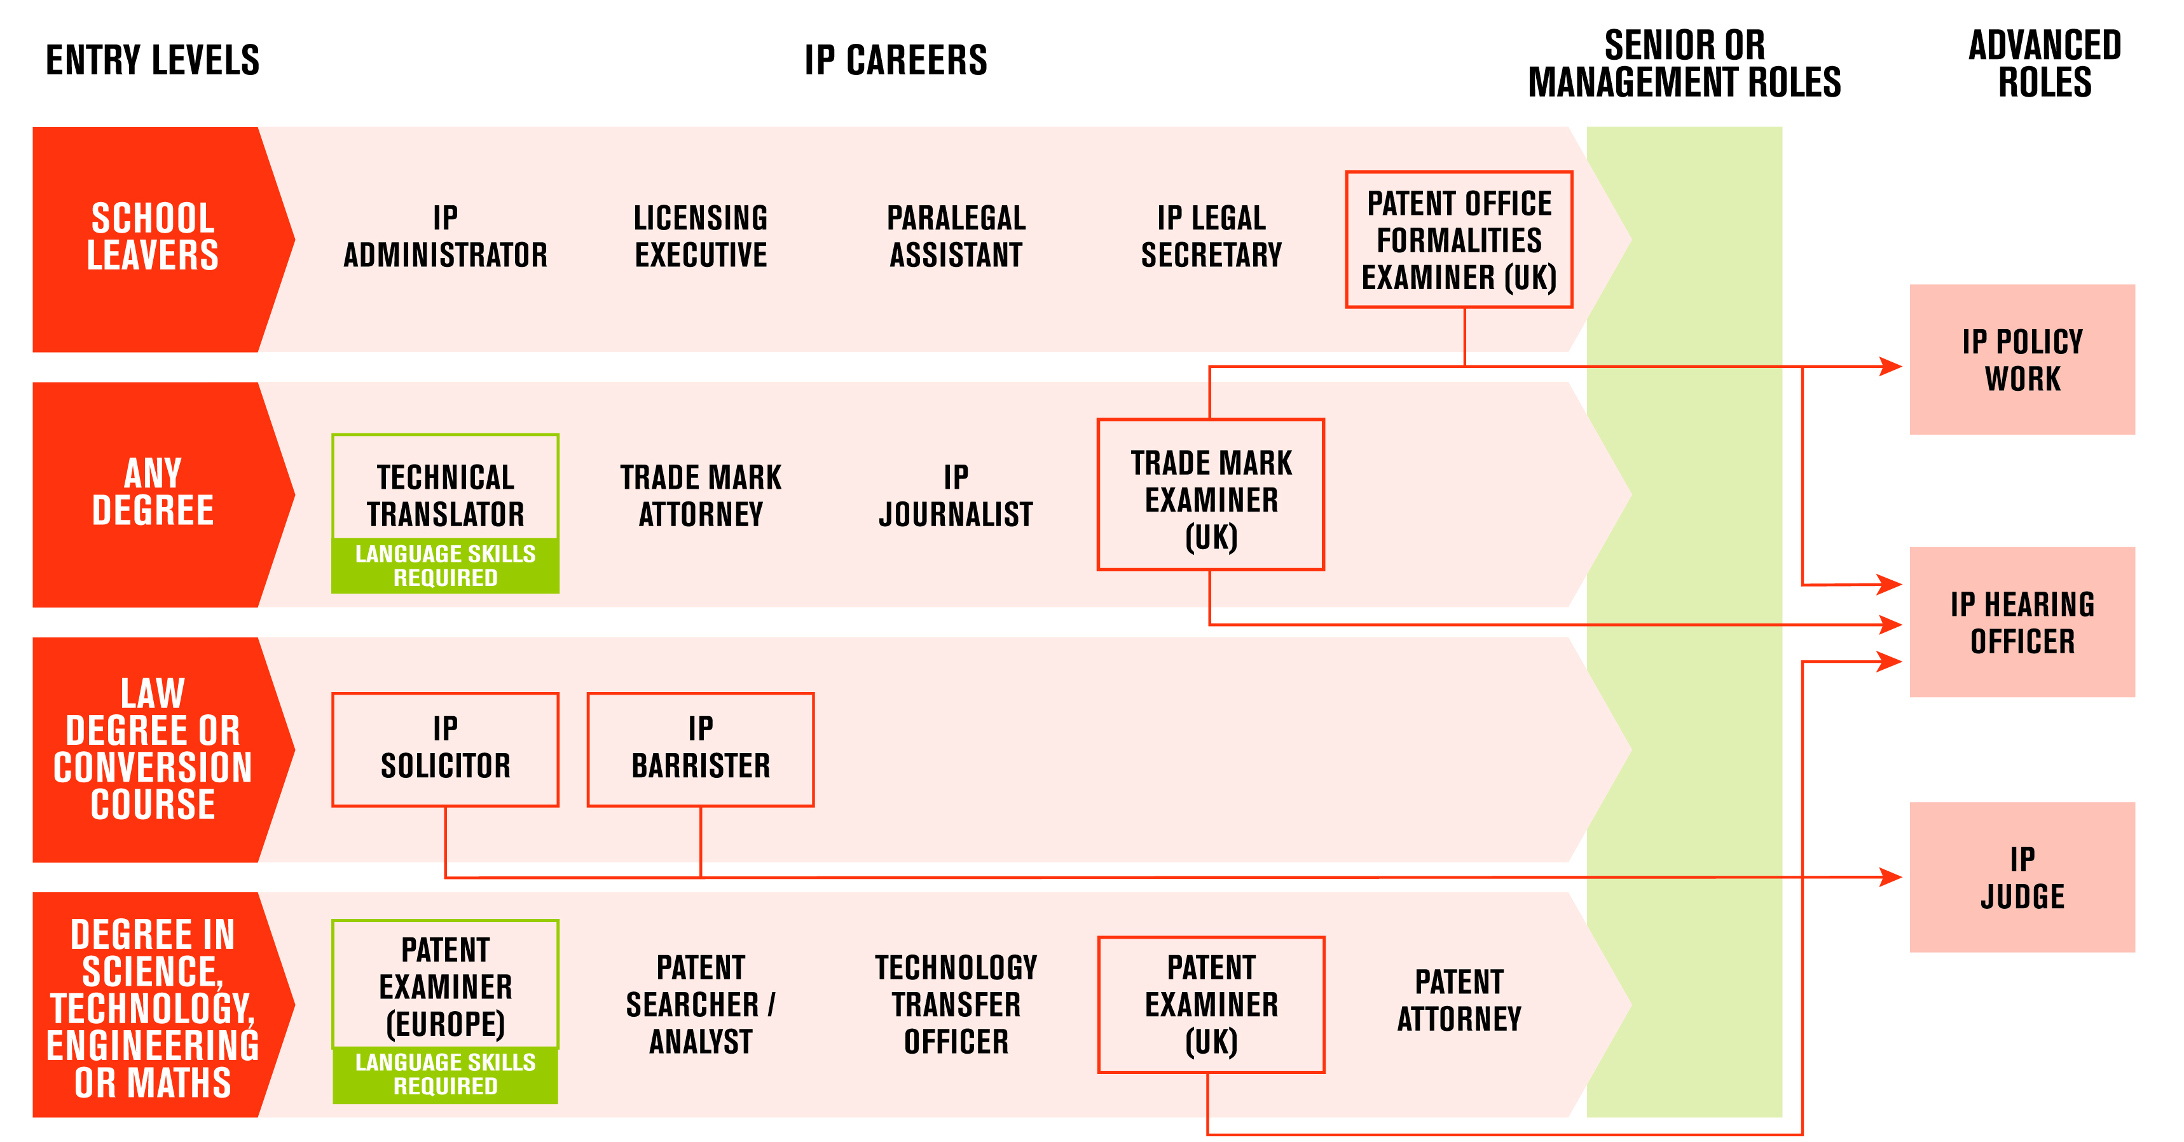
What are the careers in ideas?

